Slide 1
Nabiya Yousaf
2312514

Slide 2
Introduction:
Strokes, also known as cerebrovascular accidents, are a major global public health problem because of their high rates of morbidity and mortality. Strokes are a major cause of long-term impairment and the second greatest cause of mortality worldwide, according to the World Health Organization (WHO). In low- and middle-income nations, where access to preventive measures may be restricted and healthcare resources may be scarce, the prevalence of stroke is especially high. Given these difficulties, applying artificial intelligence (AI) has become a viable strategy for enhancing stroke care and prediction. Artificial intelligence (AI) has the potential to improve the precision and efficacy of stroke risk assessment, early identification, and individualized treatment plans by utilizing cutting-edge computational approaches and machine learning algorithms.

Slide 3
Dataset:
Our stroke prediction project is using the "Health Care Stroke Prediction Data" dataset, which we obtained from Kaggle. This dataset attempts to estimate a person's chance of having a stroke based on several health characteristics and offers insightful information on the causes that lead to strokes. This section will offer a thorough description of the dataset, covering its attributes, data sources, and extraction procedures.
The dataset includes a range of health-related characteristics for each participant as well as a signal indicating whether or not they have had a stroke. The elements of the dataset, in which each item represents a distinct individual, include medical history, lifestyle factors, and demographic data. The binary target variable has values that represent whether or not the person has experienced a stroke (1) or not (0).

Slide 4
Dataset features:
Gender: Denotes the person's gender (Male/Female/Other).
Age: Denotes the person's actual age.
Hypertension: A binary characteristic that indicates if a person has high blood pressure (1) or not (0).
Heart disease: A binary characteristic that indicates if a person has ever experienced heart illness (1) or not (0).
Marital Status: This indicates whether or not the person is married.
Work Type: Indicates the kind of work that the person is doing (private, self-employed, government job, etc.).
Residence Type: Denotes whether the person lives in a rural or urban setting.
The average glucose level in a person's blood is indicated by this number.
Body Mass Index, or BMI, is determined by taking a person's weight and height.
Smoking Status: Indicates the individual's smoking habits (e.g., never smoked, formerly smoked, smokes).

Slide 5
Preliminary Analysis:
An important first phase in the data analysis process is preliminary analysis, sometimes referred to as exploratory data analysis (EDA). It entails dissecting and comprehending a dataset's structure, features, and trends before utilizing more sophisticated statistical methods or developing prediction models. Gaining an understanding of the data, spotting abnormalities or outliers, and providing guidance for further research are the goals of preliminary analysis.
Data Cleaning:
Using data.isnull().sum(), which shows the total count of null values in each column, we looked for any missing values. We see that only ‘bmi’ has more than 200 null values
In particular, we looked into missing values in the data['bmi'].isnull().astype(int) column of the "BMI" column.

Slide 6
Preliminary Analysis:
Missing Value Imputation - BMI:
In the "BMI" column (data['bmi'].isnull().sum()), we found missing values.
To estimate missing BMI values based on other characteristics such as age, hypertension, heart disease, average glucose level, and stroke status, we employed a linear regression model (LinearRegression()).
We assessed the performance of the model using the training set (optional, not displayed here).
The projected BMI values were re-imputed into the original dataset.

Slide 7
Preliminary Analysis:
Post-Imputation Analysis:
We verified that missing values (data.isnull().sum()) had been removed.
To check for any changes, we looked over the data information again (data.info()).
Using a histogram and kernel density estimation (KDE), we were able to display the distribution of the imputed BMI data and compare it to a normal distribution (sns.histplot(), norm.fit()).
To evaluate the normality of the BMI data distribution, we made a Q-Q plot (ggplot(data, aes(sample=data['bmi']))).

Slide 8
Methods
Logistic Regression:
A supervised machine learning approach called logistic regression predicts the likelihood of a result, an occurrence, or an observation to complete binary classification problems. The output of the model is binary, or dichotomous, with two possible outcomes: true or false, 0/1, or yes/no.
By examining the correlation between one or more independent variables, logical regression divides data into distinct groups. It is often applied in predictive modeling, in which the model calculates the mathematical likelihood of an event falling into a particular category or not.

Slide 9
Methods
Support Vector Machine (SVM):
The support vector machine (SVM) is a machine learning algorithm that determines boundaries between data points based on predefined classes, labels, or outputs. It uses supervised learning models to solve complex problems related to classification, regression, and outlier detection. SVMs are widely used in many sectors, including speech and image recognition, natural language processing, healthcare, and signal processing applications. The SVM algorithm's main goal, technically, is to locate a hyperplane that divides the data points into separate classes. The hyperplane is positioned so that the classes being considered are separated by the greatest margin.

Slide 10
Results:
We used the accuracy score to assess each model's performance. The percentage of accurate predictions the model makes is measured by accuracy. The outcomes are broken down as follows:
Model Testing Accuracy Training Accuracy
Logistic Regression 70% 74%
SVM 85% 81%

Slide 11
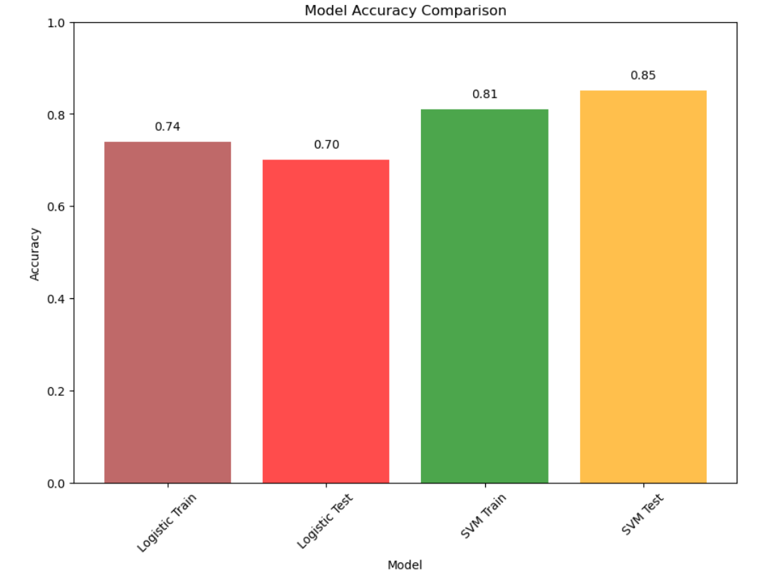
Results:
Comparison :

Slide 12
Result:
Future Exploration:
In light of these findings, additional research might focus on:
Hyper parameter tuning: Performance may be enhanced by fine-tuning hyper parameters such as the kernel coefficient in SVM or the regularization parameter in Logistic Regression.
Model Selection: For even better outcomes, consider looking into alternative machine learning models such as Gradient Boosting Machines or Random Forests.
Feature engineering: By building new characteristics off of preexisting ones, more insightful data for prediction models may be obtained.

Slide 13
Conclusion:
To sum up, this project is a major advancement in the use of artificial intelligence (AI) to meet the urgent demand for accurate and reliable stroke prediction tools. The incidence of strokes is startlingly high, especially in low- and middle-income nations where access to healthcare resources and preventive measures may be restricted. Given these obstacles, applying artificial intelligence (AI), which has the potential to improve accuracy and effectiveness in stroke risk assessment and prediction, seems like a good course of action.
In conclusion, this project highlights how artificial intelligence (AI) can be used to tackle the difficulties involved in predicting strokes, providing important information to researchers, policymakers, and medical practitioners. Our goals are to improve patient outcomes in the field of stroke prevention and management, propel future research efforts, and develop stroke care by utilizing cutting-edge computational techniques and machine learning algorithms

Slide 14
END

